Slide 2
LORD vs Lord

Slide 3
You have no authority in your teachings because you do not believe the Bible. Only your cult members controlled by peer pressure will accept your teachings when a little common sense shows your teachings are incoherent.

Slide 4
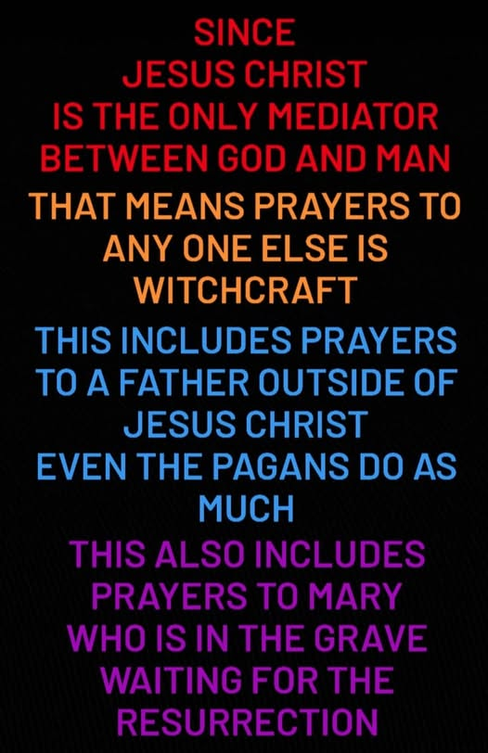

Slide 5
Ps 110:1
The Lord said unto my Lord, Sit thou at my right hand, until I make thine enemies thy footstool.

Slide 6
Heb 1:13
But to which of the angels said he at any time, Sit on my right hand, until I make thine enemies thy footstool?

Slide 7
Heb 1:1-2
God, who at sundry times and in divers manners spake in time past unto the fathers by the prophets,
Hath in these last days spoken unto us by his Son, whom he hath appointed heir of all things, by whom also he made the worlds;

Slide 8
Eph 1:3
Blessed be the God and Father of our Lord Jesus Christ, who hath blessed us with all spiritual blessings in heavenly places in Christ:

Slide 9
Eph 4:6
One God and Father of all, who is above all, and through all, and in you all.

Slide 10
Ex 20:2
I am the Lord thy God, which have brought thee out of the land of Egypt, out of the house of bondage.

Slide 11
1 Cor 8:6A
But to us there is but one God, the Father, of whom are all things, and we in him; …

Slide 12
John 20:17
Jesus saith unto her, Touch me not; for I am not yet ascended to my Father: but go to my brethren, and say unto them, I ascend unto my Father, and your Father; and to my God, and your God.

Slide 13
John 5:43
I am come in my Father's name, and ye receive me not: if another shall come in his own name, him ye will receive.

Slide 14


Slide 15
Rev 1:1
The Revelation of Jesus Christ, which God gave unto him, to shew unto his servants things which must shortly come to pass; and he sent and signified it by his angel unto his servant John:

Slide 16
John 10:30
I and my Father are one.

Slide 17
John 17:23
I in them, and thou in me, that they may be made perfect in one; and that the world may know that thou hast sent me, and hast loved them, as thou hast loved me.

Slide 18
Eph 4:5
One Lord, one faith, one baptism

Slide 19
John 10:33
The Jews answered him, saying, For a good work we stone thee not; but for blasphemy; and because that thou, being a man, makest thyself God.

Slide 20
John 5:18
Therefore the Jews sought the more to kill him, because he not only had broken the sabbath, but said also that God was his Father, making himself equal with God.

Slide 21
John 14:28
Ye have heard how I said unto you, I go away, and come again unto you. If ye loved me, ye would rejoice, because I said, I go unto the Father: for my Father is greater than I.

Slide 22
John 8:41
Ye do the deeds of your father. Then said they to him, We be not born of fornication; we have one Father, even God.

Slide 23
1 Cor 8:6B
…and one Lord Jesus Christ, by whom are all things, and we by him.

Slide 24
“lord god"

Slide 25
"lord god" - KJV = 532

Slide 26
"lord god" - OT KJV = 519

Slide 27
"lord god" - NT KJV = 13

Slide 28
"lord god" - Gen = 28

Slide 29
"lord god" - Ex = 14

Slide 30
"lord god" - Deut = 10

Slide 31
"lord god" - Josh = 17

Slide 32
"lord god" - 69 out of 532

Slide 33
"lord god" - Judges = 10 (1 of 9)

Slide 34
"lord god" - 77 out of 532

Slide 35
Judges 6:22
And when Gideon perceived that he was an angel of the Lord, Gideon said, Alas, O Lord God! for because I have seen an angel of the Lord face to face.

Slide 36
Judges 16:28
And Samson called unto the Lord, and said, O Lord God, remember me, I pray thee, and strengthen me, I pray thee, only this once, O God, that I may be at once avenged of the Philistines for my two eyes.

